Slide 1


Pixel Wars
Made by pixel art warrior

Slide 2
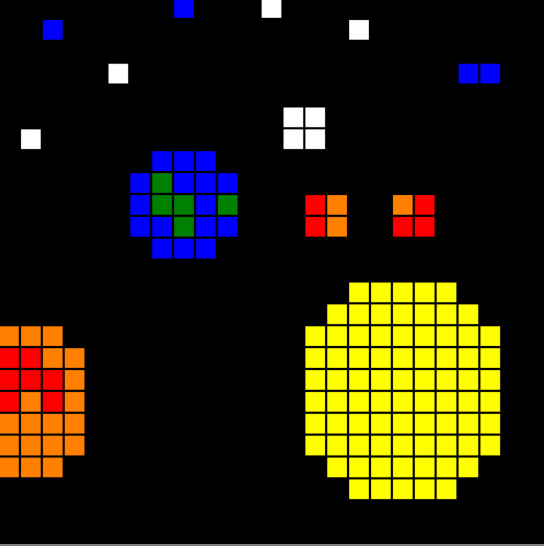
Description:
Multiplayer game
Challenge people to see who is a better artist
Improve your artistic abilities
Have fun beating others
ENJOY!!

Slide 3
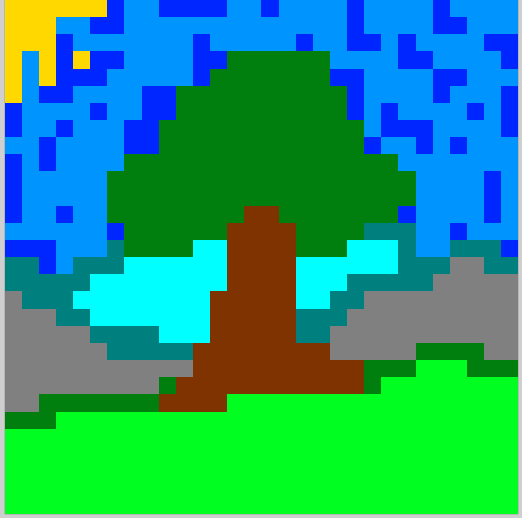
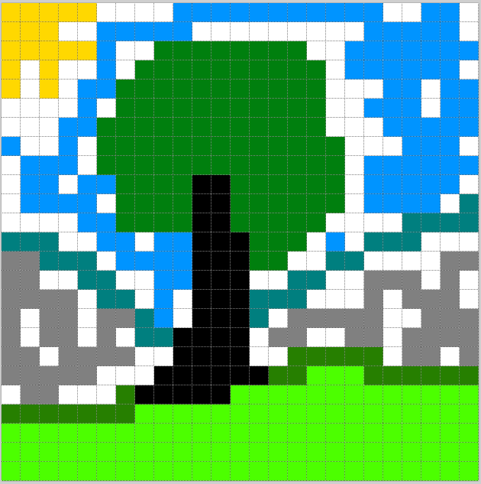
Why did we choose that idea?

Slide 4
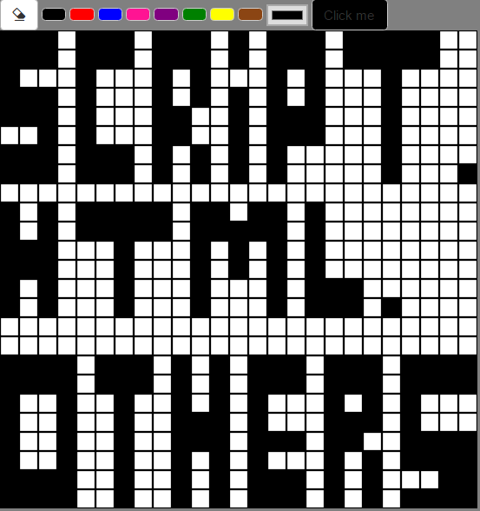

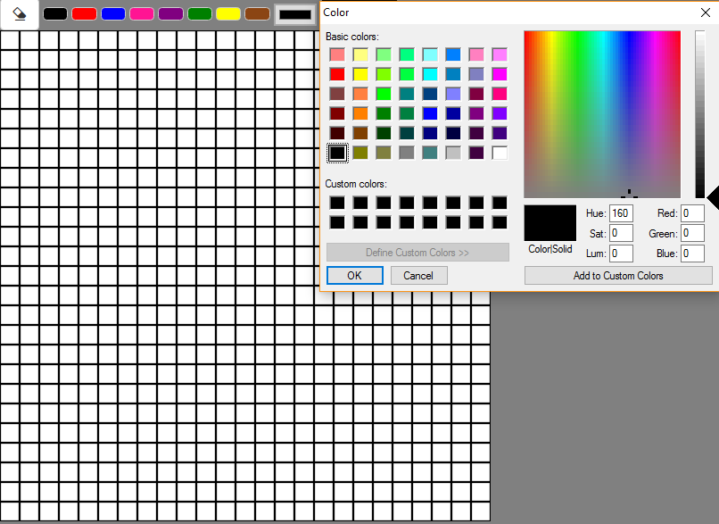


What did we use?

Slide 5

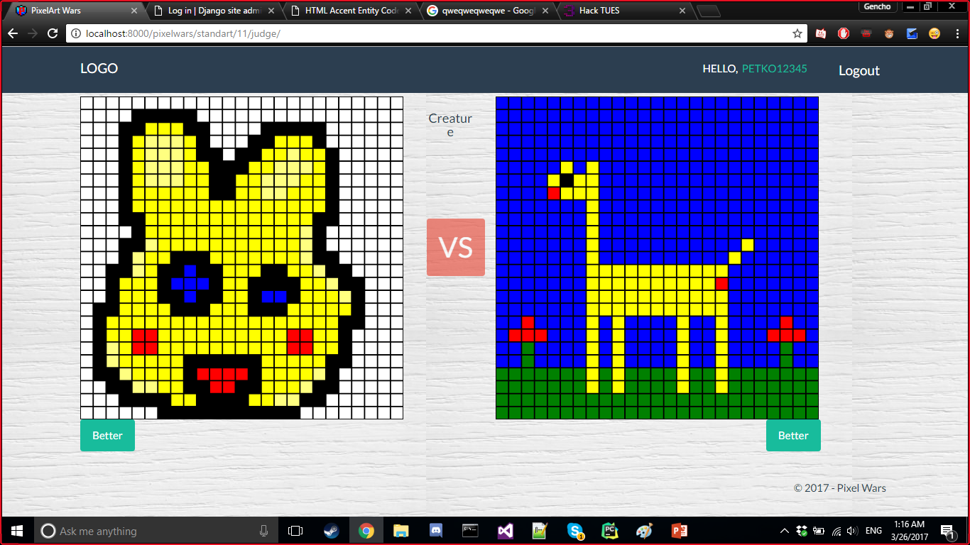
Rules
1 vs 1
Join or create new game
Two players – one description
One description – two pictures
Two pictures - two points of view
Two points of view - one winner
One winner – everybody - happy☺

Slide 6

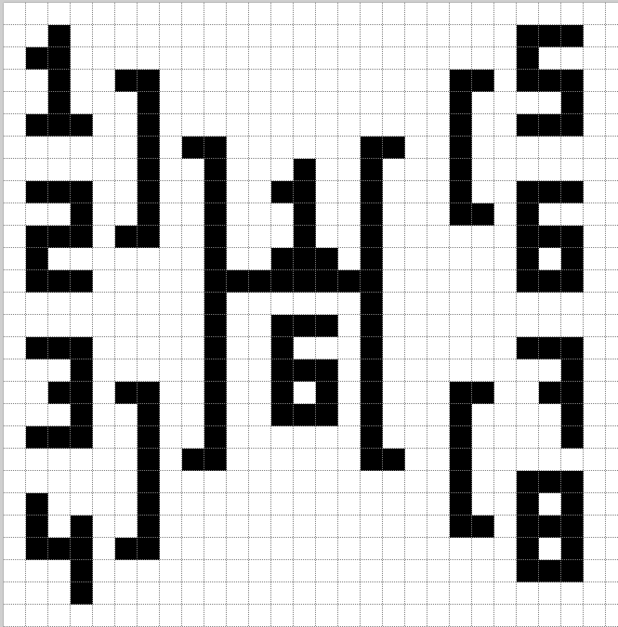
Rules
Tournament
Join a tournament every Sunday.
First round – one description
Second round
Most important rule:
4 players – 2 rounds
Judge – the admin
– second description
JOY

Slide 7
Creators
int main(){
//programmers:
string Aneta_Tsvetkova = “programmer0”;
string Evgeni_Dimov = “programator”;
string Nikola_Pavlovski= “programmer1”;
string Martin_Penev = “programmer2”;
return 0;
}

